Slide 1
Best Practices: Tape Storage Administration with DFSMSrmm
DFSMSrmm Best Practices
Horst Sinram
IBM Research & Development, Germany
Mike Wood
IBM UK

Slide 2
Trademarks
The following are trademarks of the International Business Machines Corporation in the United States, other countries, or both.
Not all common law marks used by IBM are listed on this page. Failure of a mark to appear does not mean that IBM does not use the mark nor does it mean that the product is not actively marketed or is not significant within its relevant market.
Those trademarks followed by ® are registered trademarks of IBM in the United States; all others are trademarks or common law marks of IBM in the United States.
For a complete list of IBM Trademarks, see www.ibm.com/legal/copytrade.shtml:
*, AS/400®, e business(logo)®, DBE, ESCO, eServer, FICON, IBM®, IBM (logo)®, iSeries®, MVS, OS/390®, pSeries®, RS/6000®, S/30, VM/ESA®, VSE/ESA, WebSphere®, xSeries®, z/OS®, zSeries®, z/VM®, System i, System i5, System p, System p5, System x, System z, System z9®, BladeCenter®
The following are trademarks or registered trademarks of other companies.
Adobe, the Adobe logo, PostScript, and the PostScript logo are either registered trademarks or trademarks of Adobe Systems Incorporated in the United States, and/or other countries.
Cell Broadband Engine is a trademark of Sony Computer Entertainment, Inc. in the United States, other countries, or both and is used under license therefrom.
Java and all Java-based trademarks are trademarks of Sun Microsystems, Inc. in the United States, other countries, or both.
Microsoft, Windows, Windows NT, and the Windows logo are trademarks of Microsoft Corporation in the United States, other countries, or both.
Intel, Intel logo, Intel Inside, Intel Inside logo, Intel Centrino, Intel Centrino logo, Celeron, Intel Xeon, Intel SpeedStep, Itanium, and Pentium are trademarks or registered trademarks of Intel Corporation or its subsidiaries in the United States and other countries.
UNIX is a registered trademark of The Open Group in the United States and other countries.
Linux is a registered trademark of Linus Torvalds in the United States, other countries, or both.
ITIL is a registered trademark, and a registered community trademark of the Office of Government Commerce, and is registered in the U.S. Patent and Trademark Office.
IT Infrastructure Library is a registered trademark of the Central Computer and Telecommunications Agency, which is now part of the Office of Government Commerce.
* All other products may be trademarks or registered trademarks of their respective companies.
Notes:
Performance is in Internal Throughput Rate (ITR) ratio based on measurements and projections using standard IBM benchmarks in a controlled environment. The actual throughput that any user will experience will vary depending upon considerations such as the amount of multiprogramming in the user's job stream, the I/O configuration, the storage configuration, and the workload processed. Therefore, no assurance can be given that an individual user will achieve throughput improvements equivalent to the performance ratios stated here.
IBM hardware products are manufactured from new parts, or new and serviceable used parts. Regardless, our warranty terms apply.
All customer examples cited or described in this presentation are presented as illustrations of the manner in which some customers have used IBM products and the results they may have achieved. Actual environmental costs and performance characteristics will vary depending on individual customer configurations and conditions.
This publication was produced in the United States. IBM may not offer the products, services or features discussed in this document in other countries, and the information may be subject to change without notice. Consult your local IBM business contact for information on the product or services available in your area.
All statements regarding IBM's future direction and intent are subject to change or withdrawal without notice, and represent goals and objectives only.
Information about non-IBM products is obtained from the manufacturers of those products or their published announcements. IBM has not tested those products and cannot confirm the performance, compatibility, or any other claims related to non-IBM products. Questions on the capabilities of non-IBM products should be addressed to the suppliers of those products.
Prices subject to change without notice. Contact your IBM representative or Business Partner for the most current pricing in your geography.

Slide 3

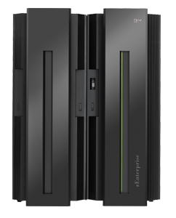



Agenda
Why DFSMSrmm best practices?
About the RMM CDS: Allocation, placement, monitoring, recovery
Using client/server – the right way
z/OS release coexistence with DFSMSrmm
Safety Nets
Diagnostics and performance hints
10100100101001
10100100101001
10100100101001
10100100101001
10100100101001
10100100101001

Slide 4
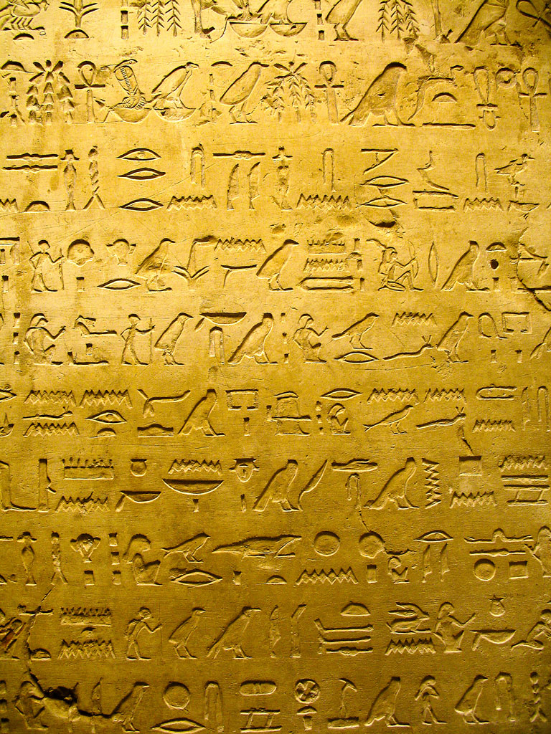
Some good reasons why you may not want to care about DFSMSrmm best practices…
Your life is boring; some excitement would come just right
Nobody in your shop knows you
Nobody in your shop –except you- knows what DFSMSrmm is
Everything is just running fine. Why care?
You can still read up the manuals when anything fails:

Slide 5
Some good reasons why you may not want to care about DFSMSrmm best practices…
Your life is boring; some excitement would come just right
Nobody in your shop knows you
Nobody in your shop –except you- knows what DFSMSrmm is
Everything is just running fine. Why care?
You can still read up the manuals when anything fails:

Slide 6
CDS Allocation, Monitoring and Maintenance
Your CDS is a crucial resource to ensure
    Continuous availability of the DFSMSrmm subsystem
    Integrity of data
      RMM-internal information
      Consistency with TCDB and Library Manager databases
    Your ability to recover quickly from problems
    DFSMSrmm performance
The following best practices apply to
  Allocation and placement
  Monitoring, and
  Maintenance of your CDS

Slide 7
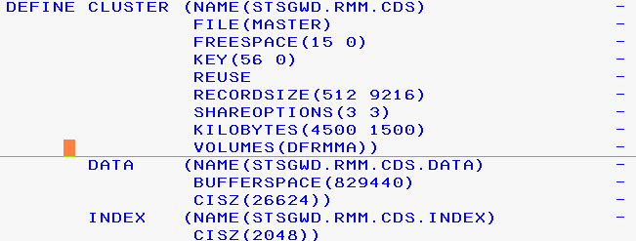
CDS Allocation
Good starting point for CDS allocation is
SYS1.SAMPLIB(EDGJMFAL)
  Already addresses CISIZEs, Bufferspace
SMS-managed is preferred
Add DATACLASS() to use
  DSNTYPE EXTended REQuired
  If your CDS is anywhere near to 4GB,
  define it such that it can extend beyond 4GB
    Specify EXTENDED ADDRESSABILITY = Y
Multi-volume allocation possible
CDS is not a good candidate for striping or compression

Slide 8
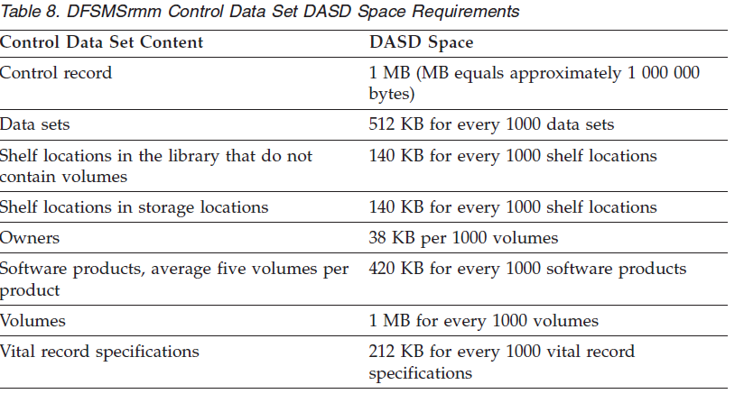
CDS Sizing
Estimate required space for CDS as documented
  … and then allocate at least twice that much as primary allocation
Add secondary allocation to allow for growth
Recommended: Use GUARANTEEDSPACE in STORAGECLASS

Slide 9
CDS Placement
CDS Placement considerations
  Space to extend on volume(s)
  Free entries in VTOC
Place on suitable volume(s)
  High performance
  Consider AVAILABILITY=CONTINUOUS
  Consider eligibility for concurrent copy/virtual concurrent copy/flashcopy
  Separate from journal data sets
If CDS will be shared across Sysplexes RESERVE/RELEASE will be used
  No other critical data should be placed on same volume(s)
  Customize GRSRNLxx to avoid GLOBAL ENQ in addition

Slide 10
CDS Monitoring (1)
Always monitor the CDS for space bottlenecks
  Objective that there is always enough space allocated, or available via secondary extensions
  It is difficult to determine actual usage of a KSDS cluster
  Focus on ensuring that the CDS either has sufficient space allocated, or that it will be able to extend. Check:
    HURBA/HARBA in RMM LISTCONTROL or LISTCAT
      Baseline of % Full changes with allocations
    Well below 123 extents/volume limit
    Free space on volume(s) sufficient for secondary allocation(s)
    VTOC space
    Current size + secondary space < 4GB or use EF & EA

Slide 11
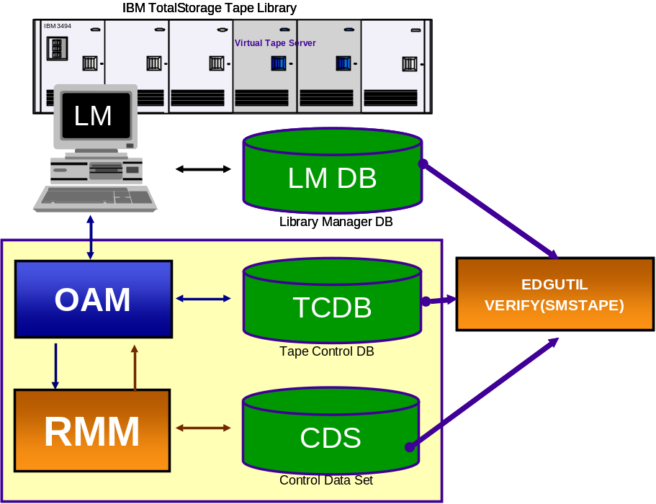
CDS Monitoring (2)
Regularly monitor the CDS for integrity
  Use EDGUTIL VERIFY(ALL) to check for CDS mismatches
  Use EDGUTIL VERIFY(SMSTAPE) to check consistency across TCDB, CDS
  and library manager database

Slide 12
CDS Maintenance
To reclaim CDS space use EDGBKUP; PARM=‘BACKUP(REORG)’
  As in SYS1.SAMPLIB(EDGJBKUP)
  After the REORG note the HURBA for later comparisons
  There is little value in REORG other than to reclaim space
    Frequent REORGs tend to increase the number of CI/CA splits required
  On z/OS V1.12 and above VSAM CA reclaim should further reduce the requirements for REORGs
Repair CDS inconsistencies
  Only when previously identified by VERIFY
  Run MEND against a copy of the CDS
    Check changes, then copy back
  Always quiesce all DFRMM subsystems sharing the CDS
Recommendation: Test your recovery and REORG procedures

Slide 13
Preparing for CDS recovery
Certain events can render the CDS unusable
  Physical data loss or corruption
  CDS update errors
    I/O errors during CDS update
    “CDS full” condition while doing multi-record updates
Recommendation: Have current and tested recovery jobs available at any time.
  Recovery strategy depends on specific situation
  Incorrect recovery attempts make the problem even worse and cause unneeded outage times
For recovery procedures, refer to “DFSMSrmm Implementation and Customization Guide”,
chapter 17: Maintaining the Control Data Set

Slide 14
Recovery strategy
Physical data loss or corruption
  The CDS needs to be recovered to the most current clean state
  Forward recovery:
    Base is the last backup taken from the CDS
    Then apply (“replay”) all subsequent changes recorded in the journal data set(s)
CDS update errors
  DFRMM auto-recovery will be attempted
  If auto-recovery fails, perform manual recovery
    Base is the currently active CDS
    Then apply all subsequent changes recorded in the journal data set(s)
Journal “replay” depends on the CDS backup format
  DSS: Start with the journal backup taken at the same time
  AMS: Start with the journal backup taken at the next backup

Slide 15

DFRMM will automatically attempt to recover
Automatic recovery
  EDG2111I DFSMSrmm STARTING AUTOMATIC RECOVERY OF THE CONTROL DATA SET
  DFRMM will automatically use the current journal to perform automatic recovery
If successful, DFRMM will continue:
  EDG2112I DFSMSrmm AUTOMATIC RECOVERY OF CONTROL DATA SET SUCCESSFUL
Otherwise manual recovery needs to be performed:
  EDG2115I RECOVERY OF CONTROL DATA SET IS REQUIRED
  EDG2116A DFSMSrmm QUIESCED - START CONTROL DATA SET RECOVERY PROCEDURE
  Possible reasons include
    Journal / CDS mismatch
    Journal not available or disabled

Slide 16
How to resolve a CDS-full condition (sample)
EDG2109I MASTER FILE IS FULL FOR FUNCTION LADD,18 -
RC=0008 REAS=001C KEY=…
*nn EDG4001D DFSMSrmm I/O ERROR IN …
ENTER "RETRY" OR "CANCEL"
EDG2110I DFSMSrmm DETECTED A FAILED CONTROL DATA SET UPDATE
EDG2111I DFSMSrmm STARTING AUTOMATIC RECOVERY OF THE CONTROL DATA SET
EDG2109I MASTER FILE IS FULL FOR FUNCTION LADD,18 - RC=0008 REAS=001C
EDG2114I AUTOMATIC RECOVERY OF CONTROL DATA SET HAS FAILED
EDG2116A DFSMSrmm QUIESCED - START CONTROL DATA SET RECOVERY PROCEDURE
*nn EDG4012D DFSMSrmm INACTIVE FOR …,ENTER "RETRY", "CANCEL" OR "CONTINUE"
Recovery:
  Do not yet reply to EDG4001D
  Do not reply to EDG4012D. Leave this message outstanding until RMM is active again after the recovery
    On refresh, RMM will continue without a reply
    Do not auto-reply to this message
  Run reorg to reclaim some space:
    // EXEC PGM=EDGBKUP,PARM=‘BACKUP(REORG)’
  Reply EDG4001D with “RETRY”

Slide 17
Agenda
Why DFSMSrmm best practices?
About the RMM CDS: Allocation, placement, monitoring, recovery
Using client/server – the right way
z/OS release coexistence with DFSMSrmm
Safety Nets
Diagnostics and performance hints
10100100101001
10100100101001
10100100101001
10100100101001
10100100101001
10100100101001

Slide 18
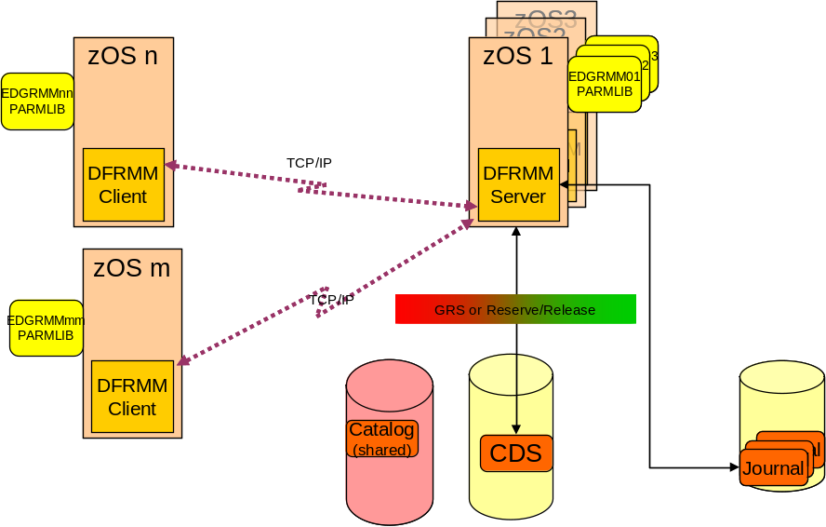
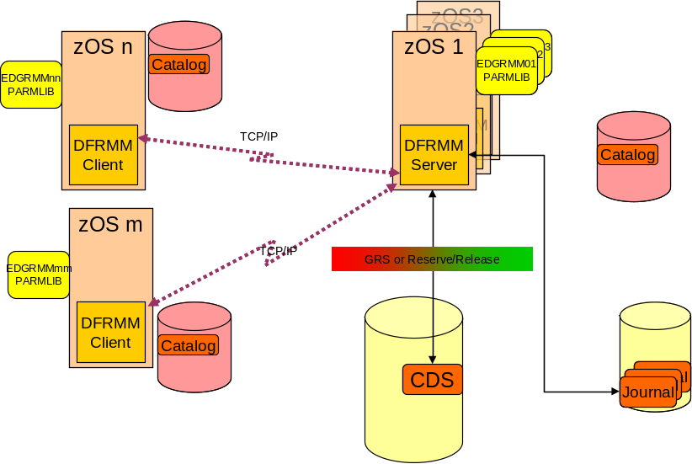
Using DFSMSrmm Client/Server the right way
Reasons for using client/server:
  Many systems that should share a common database
    and expect significant concurrent access to CDS
  No shared volumes available
  Avoids RESERVE/RELEASE
    Hyperswap manager does not tolerate cross-plex sharing
  Catalogs may be shared or
  non-shared
Prerequisites for using client/server
  Reliable network (TCP/IP) connectivity
  All coexistence maintenance applied
    Same coexistence requirements as for non-C/S environment!
  Adjust RMM usage and operational procedures for C/S – see next chart
Notes:
RESERVE/RELEASE prevents use of Hyperswap with Hyperswap manager
See using rmm in storage solutions.ppt in GSA

Slide 19
C/S Topology – Shared Catalog
zOS3
zOS2
zOS n
zOS 1
EDGRMM03
PARMLIB
EDGRMM02
PARMLIB
EDGRMMnn
PARMLIB
EDGRMM01
PARMLIB
DFRMM
DFRMM
DFRMM
Client
TCP/IP
DFRMM
Server
zOS m
EDGRMMmm
PARMLIB
TCP/IP
GRS or Reserve/Release
DFRMM
Client
Catalog
(shared)
CDS
Journal
Journal
Journal

Slide 20
C/S Topology – Non-shared Catalogs
zOS3
zOS2
zOS n
zOS 1
EDGRMM03
PARMLIB
EDGRMM02
PARMLIB
EDGRMMnn
PARMLIB
Catalog
EDGRMM01
PARMLIB
DFRMM
DFRMM
DFRMM
Client
TCP/IP
DFRMM
Server
Catalog
zOS m
EDGRMMmm
PARMLIB
TCP/IP
GRS or Reserve/Release
DFRMM
Client
Catalog
CDS
Journal
Journal
Journal

Slide 21
DFSMSrmm Operations und usage in a
Client/Server Environment
Must run on client:
CATSYNCH
EXPROC
Must run on server:
BACKUP
Should run on server:
VRSEL
DSTORE
RPTEXT
See next chart for actions to be performed on client side if catalog is not shared.
Preferably use server for all tasks that do not require to run on client.
Notes:
EDGHSKP parms:
CATSYNCH processing
VRSEL vital record processing
DSTORE storage location management processing
EXPROC expiration processing
RPTEXT extract data set creation
BACKUP control data set and journal back up processing

Slide 22
Some special considerations apply in a Client/Server environment with non-shared catalogs
CATSYSID must define list of systems that share catalogs with the system
Catalogs and CDS may need resynchronization:
  Identified EDGHSKP CATSYNCH/VERIFY
  Synchronization was lost because RMM was unavailable or errors occurred
  User catalogs were connected or disconnected
SYSID(SYS2) CATSYSID(SYS1,SYS2, … )
SYSID(SYSn) CATSYSID(SYSn) CLIENT()
SYSID(SYS1) CATSYSID(SYS1,SYS2, …) SERVER()
EDGHSKP CATSYNCH
EDGHSKP CATSYNCH
EDGUTIL UPDATE CONTROL CATSYNCH(YES)
SYSID(SYSm) CATSYSID(SYSm) CLIENT()
EDGHSKP CATSYNCH
Use client to:
  Eject a volume
  Add volumes using STATUS(VOLCAT)
  Change volume attributes maintained in the TCDB
  Return to scratch with uncatalog
Notes:
You must re-synchronize the DFSMSrmm control data set and user catalogs under
these conditions:
v You ran EDGHSKP with CATSYNCH and VERIFY, and differences in catalog
status were found that you believe should be corrected. After you have made
any corrections to the catalogs, either run CATSYNCH without VERIFY or use
the EDGUTIL utility with the UPDATE option to reset the catalog
synchronization date. EDGUTIL clears the catalog synchronization date and time
to force you to run CATSYNCH.
v DFSMSrmm is not active when catalog activity for tape data sets is taking place.
DFSMSrmm issues messages EDG8200E and EDG8201E when DFSMSrmm
cannot track catalog updates.
v A DFSMSrmm failure occurs during catalog processing. DFSMSrmm issues
EDG8200E and EDG8201E when an error is detected in processing.
v You connect or disconnect user catalogs, that contain entries for tape data sets,
to the master catalog.

Slide 23
Agenda
Why DFSMSrmm best practices?
About the RMM CDS: Allocation, placement, monitoring, recovery
Using client/server – the right way
z/OS release coexistence with DFSMSrmm
Safety Nets
Diagnostics and performance hints
10100100101001
10100100101001
10100100101001
10100100101001
10100100101001
10100100101001

Slide 24
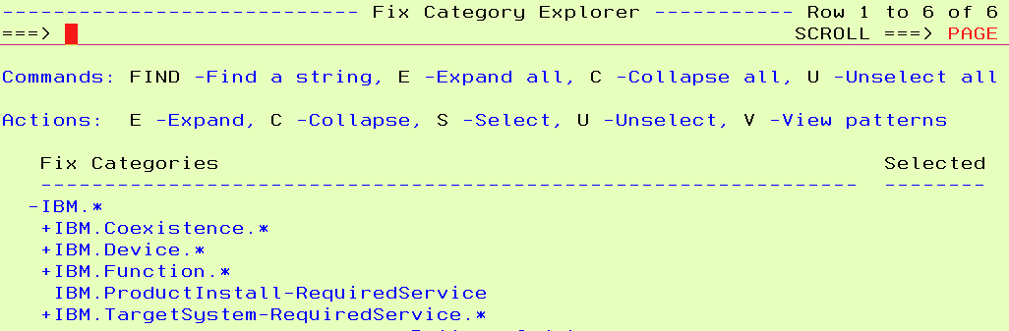
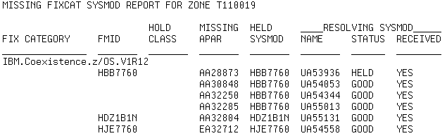
z/OS release coexistence with DFSMSrmm
DFSMSrmm follows z/OS rules for coexistence
Coexistence maintenance is critical if CDS is shared across different releases of z/OS
Any migration actions required?
→ Check z/OS migration guides applicable to your releases
→ Run migration checks identified for the target release (if any)
    Refer to DFSMSrmm migration health checks for V1R11
    MODIFY HZSPROC,ACTIVATE,CHECK=(IBM,ZOSMIGV1R11_RMM_*)
Any coexistence maintenance required?
→ Run SMP/E FIXCAT to check all required service is applied
Notes:
OA26947: DFSMSrmm migration health checks for V1R11
The IBM Health Checker for z/OS is extended with new migration checks for DFSMSrmm. These checks are designed to help you to determine if DFSMSrmm is correctly configured and is consistent with IBM's recommendations.
The IBM Health Checker for z/OS now includes the following checks for DFSMSrmm -
ZOSMIGV1R11_RMM_DUPLICATE_GDG
ZOSMIGV1R11_RMM_REXX_STEM, and
ZOSMIGV1R11_RMM_VRSEL_OLD.
At DFSMSrmm subsystem start-up, once the subsystem is fully established, DFSMSrmm dynamically adds its exit routine to the HZSADDCHECK exit and dynamically adds/updates the supported migration and health checks. Also, any time that DFSMSrmm subsystem is stopped or refreshed, the checks are deleted so that no further health check processing can be run until DFSMSrmm is restarted successfully.
The DFSMSrmm migration and health checks require that both Health Checker and System Rexx are configured and active. The checks are shipped as compiled Rexx and can run under either the Library for Rexx on zSeries or the Alternate Library for Rexx on zSeries.
These Health Checks are shipped INACTIVE, and must be ACTIVATEd to run.
To use these Health Checks for DFSMSrmm migration purposes, follow these instructions:
Install this PTF, and restart or IPL the system as indicated in the ++HOLD for RESTART or IPL.
ACTIVATE these checks. There are many ways to activate a check, such as through SDSF or a MODIFY command. You may use wildcards to ACTIVATE checks, if you wish. To ACTIVATE the checks using the MODIFY command, issue:
MODIFY HZSPROC,ACTIVATE,CHECK=(IBM,ZOSMIGV1R11_RMM_*)
Review the Health Check output. Re-run as appropriate.

Slide 25
New Function Overview
z/OS (RMM) release Function | z/OS V1.12 | z/OS V1.11 | z/OS V1.10 | z/OS V1.9
Retention limit reporting | + | OA30881 | OA30881
Volume Hold EAS Eligibility OPENRULE IGNORE IPv6 AUTOR Add. Status commands & RAS enhancements | +
Option to turn uppercasing on/off | + | OA32661 | OA32661 | OA32661
TS7700 1.6 Support , Logical WORM | + | OA28637 | OA28637 | OA28637
Report generator extensions | + | +
Migration checks for z/OS V1.11+ coexistence | + | OA32028 | OA26947 OA32028 | OA26947 OA32028
z/OS V1.11+ coexistence | - | - | OA25714 OA28232 | OA25714 OA28232
+: Support integrated into release base

Slide 26
Agenda
Why DFSMSrmm best practices?
About the RMM CDS: Allocation, placement, monitoring, recovery
Using client/server – the right way
z/OS release coexistence with DFSMSrmm
Safety Nets and Library Partitioning
Diagnostics and performance hints
10100100101001
10100100101001
10100100101001
10100100101001
10100100101001
10100100101001

Slide 27
Exploit additional safety nets for your data
Some problems may cause volumes to be dropped that really should be retained
  Incorrect VRS changes
  Operational problems
  Bugs ☹
DFSMSrmm offers capabilities to
  Alert you when an unexpected amount of volumes are dropped
  Prevent volumes from being dropped permanently
Use these features as an additional safety net to prevent data loss
  EXPDTDROP / VRSDROP / VRSRETAIN
    Thresholds may be specified as absolute numbers or as percentages.
    If threshold is exceeded INFO, WARN, or FAIL actions be performed.
  Volume “Hold” attribute prevents a volume being set to pending release

Slide 28
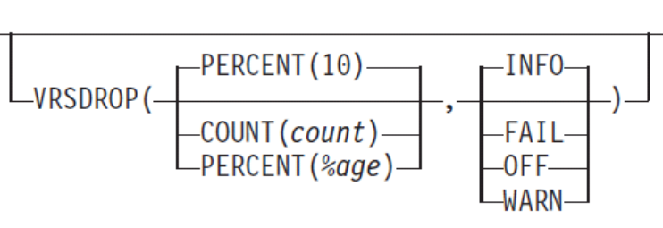
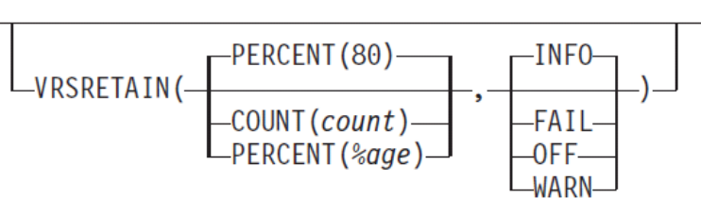
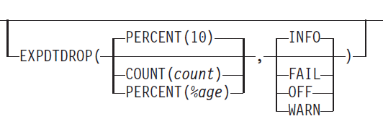
Safety net: EXPDTDROP / VRSDROP / VRSRETAIN
VRSDROP to specifies how many existing VRS-retained volumes may be dropped from vital records retention and the action to be taken by DFSMSrmm.
VRSRETAIN specifies how many newly assigned volumes are to be retained by vital records retention.
  A newly assigned volume is one that has a volume assignment time that is higher than the run time of the previous VRSEL processing and that is not VRS-retained.
EXPDTDROP specifies how many existing expiration date retained volumes may be dropped from retention. An EXPDT-retained volume is one that is not VRS-retained and is not newly assigned
  EXPROC: additional processing may be required
OA33526
required
Notes:
Use VRSDROP to specify a maximum number or percentage of existing VRS-retained volumes that can be dropped from vital records retention and the action to be taken by DFSMSrmm. DFSMSrmm counts the number of VRS-retained physical and logical volumes at the start of vital record selection processing and the number of these dropped by vital record processing.
Use VRSRETAIN to specify a minimum number or percentage of newly assigned volumes that are to be retained by vital records retention and the action to be taken by DFSMSrmm. A newly assigned volume is one that has a volume assignment date and time that is higher than the run date and time of the previous VRSEL processing and that is not VRS-retained. DFSMSrmm counts the number of newly assigned physical and logical volumes at the start of vital record selection processing and the number of these that become VRS retained by vital record processing.
Use EXPDTDROP to specify a maximum number or percentage of existing expiration date retained volumes that can be dropped from retention and the action to be taken by DFSMSrmm. DFSMSrmm counts the number of EXPDT-retained physical and logical volumes at the start of inventory management expiration processing and the number of these to be set to pending release. An EXPDT-retained volume is one that is not VRS-retained and is not newly assigned.

Slide 29
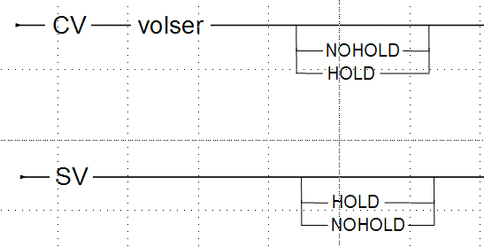
Safety net: Volume “Hold”
Volume “Hold” attribute
  prevents a volume being set to pending release
  only valid for non-scratch, non-pending release volumes
  DV RELEASE subcommands fail if the HOLD attribute is set
    DV FORCE is accepted as per normal
  new HY and HN line commands
The hold attribute is only honored on z/OS V1.12 and above. Lower levels ignore it!

Slide 30
System Managed Library Partitioning Prior to z/OS V1.10
(Client/Server)
IBM 3494
Virtual Tape Server
IBM 3494
Virtual Tape Server
IBM 3494
Virtual Tape Server
IBM 3494
Virtual Tape Server
CDS
CDS
TCDB
CDS
CDS
CDS
TCDB
CDS
TCDB
TCDB
TCDB
TCDB
  1:1
Partitioned
  by exits
  CBRUXENT
  EDGUX200
  scratch categories
EXPROC by system
Shared private
1:n
Partitioned
  by cds/system
  REJECT ANYUSE
  Scratch categories
EXPROC by CDS
Shared private
use 98000
n:n
Partitioned
  by system
  REJECT ANYUSE
  Scratch categories
EXPROC by CDS
No shared private
  add TCDBentry &
  98000
n:1
Partitioned
  by system
  custom CBRUXENT
  Scratch categories
EXPROC by TCDB
No shared private
  add TCDBentry

Slide 31
System Managed Library Partitioning (Current)
2 Ways to control entry processing
  REJECT ANYUSE(*)
    All volumes undefined in RMM CDS left in insert category
    Must pre-define volumes to enable entry of volumes
  No REJECTs or Selective REJECTs
    All un-REJECTed volumes added automatically to RMM CDS
    Pre-define volumes to RMM as an exception based on
      volume status
      ISMF library default entry status
Any alternative requires CBRUXENT exit customization
  For 1:1 case, EDGUX200 logic must match that in CBRUXENT
EDGUX200 is required if RMM CDS contains volumes from multiple partitions and TCDB is shared or has entries created manually for private sharing
  CATSYSID(sysid_list) can be used instead of EDGUX200
  Run EXPROC once per scratch category set

Slide 32
System Managed Library Partitioning (z/OS V1.10)
Addresses many problems:
  REJECT used for both OPEN and Partitioning
    New PRTITION and OPENRULE statement
  Complex environments are unmanageable because of number of REJECTs
    New options on OPENRULE/PRTITION that allow global action setting then one or more specific overrides based on different options
  REJECT for partitioning is not effective in Client/Server or if CDS is shared
    New PRTITION statement allows both RMM and NORMM volumes to be handled
  Only PREFIX can be defined
    VOLUMERANGE and VOLUME allow more flexibility including specific and generic volser
  IGNORE support requires EDGUX100 / EXPDT=98000
    OPENRULE with ACTION(IGNORE) avoids the need for EDGUX100 customization or JCL EXPDT=98000
  OPENRULE action REJECT based on creating system
    Force data sets to be cataloged
    Cross-check creating SYSID
Recommendation
  Use PRTITION / OPENRULE rather than REJECTs!

Slide 33
PRTITION Syntax
s
PRTITION
selection
action
s
selection
VOLUME( VolserOrPrefix )
s
ALL
VOLUMERANGE(‘Start’:’End’ )
TYPE(
RMM
)
NORMM
action
SMT(
ACCEPT
)
NOSMT(
ACCEPT
LOCATION( SHELF ) )
s
s
SMT(
IGNORE
)
NOSMT(
IGNORE
)
ACCEPT
ACCEPT
SHELF
LOCATION(
LocdefHome
)
Default entries created from this command
PRTITION VOLUME(*) TYPE(ALL) SMT(ACCEPT) NOSMT(ACCEPT LOCATION(SHELF))

Slide 34
OPENRULE Syntax
s
OPENRULE
selection
s
intent
selection
s
VOLUME( VolserOrPrefix )
s
ALL
TYPE(
RMM
)
VOLUMERANGE( ‘Start’:’End’ )
NORMM
intent
ANYUSE(ACCEPT)
s
s
INPUT( action )
OUTPUT( action )
ANYUSE( action )
action
ACCEPT
s
ACCEPT
s
REJECT
BY(
SYSID
)
IGNORE
CATLG
ANY
BY(
NONSPECIFIC
)
SPECIFIC
Default entries created from this command
OPENRULE VOLUME(*) TYPE(ALL) ANYUSE(ACCEPT)

Slide 35
System Managed Library Partitioning z/OS V1.10 and above. . .
Parmlib Control using
  PRTITION VOLUME(prefix) SMT(action)
  Automatic define unless SMT(IGNORE)
  OAM Leaves in INSERT category
At OPEN time
  OPENRULE determines if Use is rejected
  Can be ignored using
    ANYUSE(IGNORE) VOLUME(prefix)
    EDGUX100
A00000-A04999
B00000-B04999
PRTITION SMT(IGNORE)
TYPE(ALL) VOLUME(B*)
IBM 3494
Virtual Tape Server
CDS
TCDB
X
PRTITION
SMT(IGNORE) TYPE(NORMM) VOLUME(*)
CDS
TCDB

Slide 36
System Managed Library Partitioning . . .
Updated to reflect new options in z/OS 1.10
(Client/Server)
IBM 3494
Virtual Tape Server
IBM 3494
Virtual Tape Server
IBM 3494
Virtual Tape Server
IBM 3494
Virtual Tape Server
CDS
CDS
TCDB
CDS
CDS
CDS
TCDB
CDS
TCDB
TCDB
TCDB
TCDB
  1:1
Partitioned
  by system
  PRTITION
  scratch categories
EXPROC by system
PRTITION
Shared private
1:n
Partitioned
  by cds/system
  PRTITION
  Scratch categories
EXPROC by CDS
Shared private
n:n
Partitioned
  by system
  PRTITION
  Scratch categories
EXPROC by CDS
No shared private
  add TCDBentry &
  Use; 98000, or, OPENRULE with ANYUSE(IGNORE)
n:1
Partitioned
  by system
  PRTITION
  Scratch categories
EXPROC by TCDB
or PRTITION
No shared private
  add TCDBentry &
  Use; 98000, or, OPENRULE with ANYUSE(IGNORE)

Slide 37
System Managed Library Partitioning . . .
Updated to reflect new options in z/OS 1.10
Ways to control entry processing
  PRTITION TYPE(NORMM) VOLUME(*) SMT(IGNORE)
    All volumes undefined in RMM CDS left in insert category
    Must pre-define volumes to enable entry of volumes
  No PRTITIONs and no OPENRULE
    Processing is as for earlier releases
  Selective PRTITIONs
    All ACCEPTed volumes added automatically to RMM CDS
      ISMF library default entry status
    Pre-defined volumes only considered for TYPE(RMM) cases
      volume status set by RMM during volume entry
Any alternative requires CBRUXENT exit customization
  In most cases this can now be avoided
For EXPROC
  PRTITION TYPE(ALL/RMM) action IGNORE skips exproc SCRATCH processing
    Even if TCDB Entry Exists (TCDB shared or created manually for private sharing)
  CATSYSID(sysid_list) can also be used to skip volumes
  Run EXPROC once per scratch category set

Slide 38
Agenda
Why DFSMSrmm best practices?
About the RMM CDS: Allocation, placement, monitoring, recovery
Using client/server – the right way
z/OS release coexistence with DFSMSrmm
Diagnostics and performance hints
10100100101001
10100100101001
10100100101001
10100100101001
10100100101001
10100100101001

Slide 39
Just in case: Collect diagnostic information
Collect PDA trace diagnostics
  Valuable for identifying RMM logic problems at a very small expense
  The PDA facility consists of
    in-storage trace (PDA), and
    optional DASD log data sets. Identified by their DD names, EDGPDOX and EDGPDOY.
  Recommendation:
    In EDGRMMxx specify OPTION PDA(ON) PDALOG(ON)
    Have sufficiently sized PDA log data sets defined
    For sizing refer to appendixes “Problem Determination Aid Log Data Set SizeWork Sheet for Long/Short-Term Trace History” in
    “DFSMSrmm Implementation and Customization Guide”
      ROT: Begin with 50 CYL (3390)
Collect RMM SMF records
  Use the IBM assigned SMF record type of 42, the audit records subtype of 22, and the security records subtype of 23.
  OPTION SMFAUD(YES) and SMFSEC(YES).
Notes:
SMFSEC is rarely used, because RACF audit can do similar things, but, EDGAUD utilit can provide a simple report for high security tape data set usage.
SMFAUD is recommended –
It can be used for recovery in an emergency via EDGBKUP forward recovery
EDGAUD utility can use these records as an audit trail to help track volumes and related records over time

Slide 40
Just in case: Keep the output of your STCs and housekeeping jobs
Output of the RMM started tasks and housekeeping jobs should be kept for “some” time
  Duration depends on the cycle times of your RMM-processes
  These jobs may provide important information if a problem is detected
    What decisions were taken?
    When were first symptoms of the problem visible
    What steps might have been involved and eventually lead to the problem?
What output?
  JES joblog / Syslog/Operlog
  Output data sets
    MESSAGE, REPORT, ACTIVITY files
    Keep a cycle of generations

Slide 41
Recommended RMM options and performance hints
Recommendation: Synchronize catalogs
  CATSYSID(…)/CATSYNCH
  Upon the following messages synchronization needs to be re-established:
    EDG8200E DFSMSrmm INACTIVE DURING CATALOG PROCESSING FOR DATA SET …
    EDG8201E DFSMSrmm SUBSYSTEM REQUEST FAILED RETURN CODE … DURING CATALOG PROCESSING FOR DATA SET …
    Should be automated
Workload Management (WLM) classification of DFRMM address space
  DFRMM is a system task serving many other jobs
  Requires appropriately high classification in WLM service definition
  Recommended: SYSSTC
    Alternatively: Single period service class with a high importance and tight velocity goal
  Same consideration applies to RMM housekeeping jobs
    Depending on setup, JES-managed initiators may result in faster initiation

Slide 42
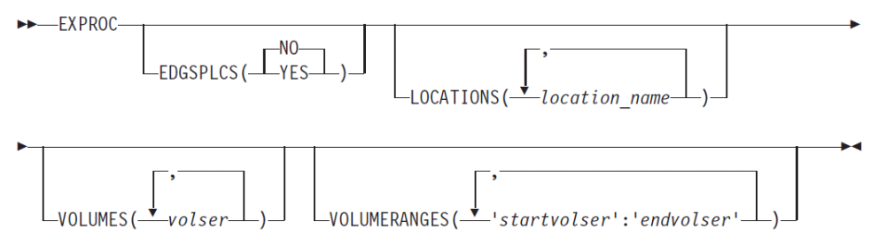
Use EDGSPLCS for parallel library updates
Specify EDGSPLCS(YES) on EXPROC to create that file
Run multiple copies of EDGSPLCS so that processing can be done in parallel for multiple libraries
//EXEC PGM=EDGSPLCS,PARM=’ACTION(S),LOCATION(ATLBA999)’
//INDD DD DISP=SHR,DSN=my.edgsplcs.data.set
//OUTDD DD SYSOUT=*
//EXEC PGM=EDGSPLCS,PARM=’ACTION(S),LOCATION(ATLBA111)’
//INDD DD DISP=SHR,DSN=my.edgsplcs.data.set
//OUTDD DD SYSOUT=*

Slide 43
Questions
What other areas do you feel require attention?
What events did lead to problems or even outages in your environment?

Slide 44









Thank you!
Hindi
Traditional Chinese
Thai
Gracias
Russian
Thank You
Spanish
Obrigado
English
Brazilian Portuguese
Arabic
Danke
Bedankt
Grazie
German
Merci
Dutch
Italian
Simplified Chinese
French
Tamil
Japanese
Korean

Slide 45
Backup

Slide 46
zOS3
zOS2
zOS n
zOS 1
EDGRMM03
PARMLIB
EDGRMM02
PARMLIB
EDGRMMnn
PARMLIB
EDGRMM01
PARMLIB
DFRMM
DFRMM
DFRMM
Client
TCP/IP
DFRMM
Server
zOS m
EDGRMMmm
PARMLIB
TCP/IP
GRS or Reserve/Release
DFRMM
Client
Catalog
(shared)
CDS
Journal
Journal
Journal

Slide 47
zOS3
zOS2
zOS n
zOS 1
EDGRMM03
PARMLIB
EDGRMM02
PARMLIB
EDGRMMnn
PARMLIB
Catalog
EDGRMM01
PARMLIB
DFRMM
DFRMM
DFRMM
Client
TCP/IP
DFRMM
Server
Catalog
zOS m
EDGRMMmm
PARMLIB
TCP/IP
GRS or Reserve/Release
DFRMM
Client
Catalog
CDS
Journal
Journal
Journal

Slide 48
